Slide 1

What is Blockchain?
1

Slide 2

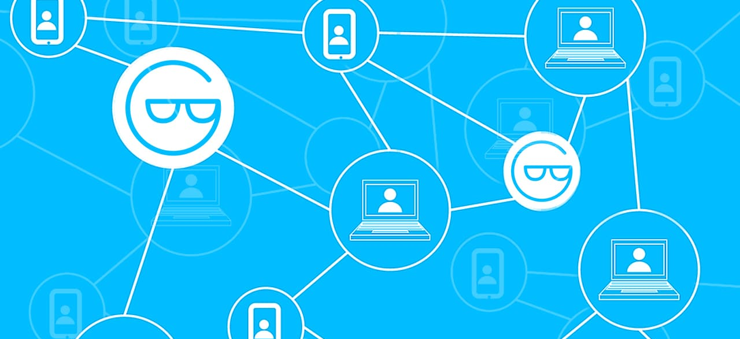
What is Blockchain?
Blockchain is a distributed database existing on various computers at the same time.
A decentralized ledger tracking digital assets on P2P network.
Some analogies for Blockchain.
Any real life example?
Records your sale & purchase of raw material
Even your bank account statements
An excel sheet tracking all hospital equipments
Simply a large sized book

Slide 3
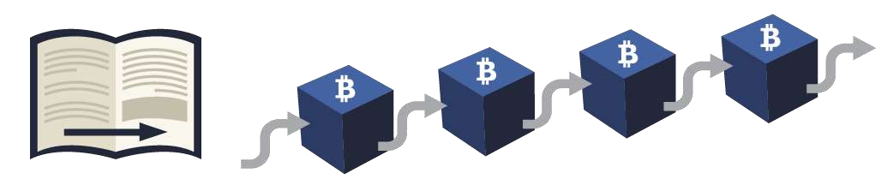
Book Analogy
Imagine it as a traditional book based ledger, where each page refers to a block connected to the previous
page through a page number
Book = Blockchain, Page = Block, an entry in page = blockchain transaction Easy to detect if a page/block has been removed or deleted
Easy to arrange the pages/blocks & identify suspicious activity. That’s why page numbers are important in a ledger.
Since the pages/blocks are built tightly on top of each other it is impossible to tamper a previous entry in the ledger without someone noticing it.

Slide 4
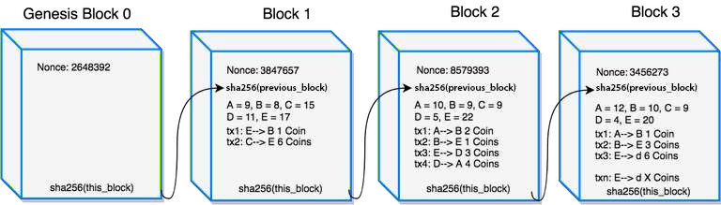
Peek Inside Blockchain

Slide 5
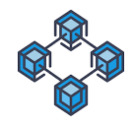
More on Blockchain
In case of a real Blockchain, each block is built on top of the new block using the previous block’s
content/signature + Nonce (random string).
Building a block & adding it in the Blockchain is a task of miner nodes (optional).
In public Blockchain, it is made computationally difficult to add a block to prevent attacks.
Miners try to guess a number (nonce) in such a way that if it gets crunched with the most recent block’s fingerprint, then it will create a new fingerprint for the Block.
It takes time & computational power to add a Block in the Blockchain. Hence there is a reward (12.5
BTC in case of Bitcoin Blockchain, 5 ETH in Ethereum)
Private Blockchains can choose other methods to add a block as they can trust the miners using a
contract etc.

Slide 6
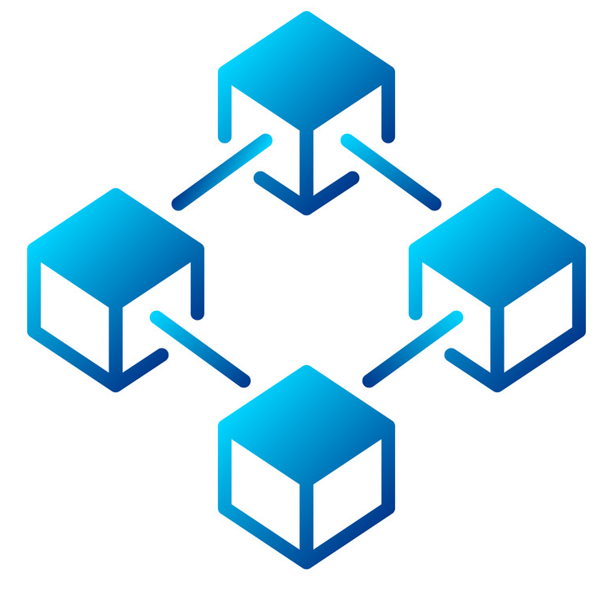
Make you own Definition for Blockchain
Let's build our definition
It’s a decentralised database which stores information in the form of transactions
It can be public or private
Stored data is immutable
Highly secure
Data gets recorded via consensus-based algorithms
Uses cryptography
Generally, exists over a peer-to-peer network
So here is our definition:
“Blockchain is a consensus-based secure decentralised public/private database which stores
information immutably over a peer-to-peer network”.

Slide 7

Summary
It is a decentralised distributed ledger (data structure) where data is being stored inside blocks in the
form of transactions.
Removes the dependency on a trusted third party for recording the data in blocks.
In public Blockchains, more complex algorithms are required to avoid malicious activities.
Since each block is built on top of the previous block, the immutability has been achieved.
Here immutability means, it is difficult to fake/alter a block & very easy to detect the tampering.
This all exists in the memory of the computers and runs as a computer process.
Every participant in Blockchain contains an almost same copy of the Blockchain ledger.

Slide 8
THANK YOU!

